Slide 1
CodeBreakers

Slide 2
Content
About the team
01
02
03
Project Idea
The Product
04
Demonstration

Slide 3
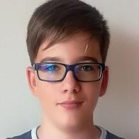
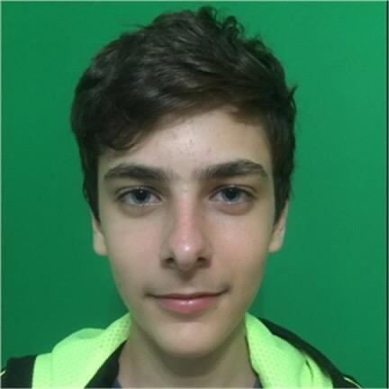
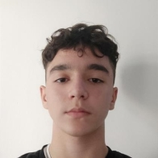
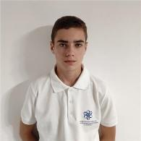
About the team
Andrey Mutlu – Scrum Trainer
Dimitar Staykov– Designer
Ivan Tsrangalov – Front-end developer
Emil Bogdanov – Back-end developer

Slide 4
Project idea
The idea behind the project was to create a game that is not only interesting to play, but also educational, and then implement it in our site.

Slide 5
The Product
Website
Game
Documentation
We created Homepage, About us, Contact us and Gamepage.
We created a country guesser.
Documentation and Presentation.

Slide 6
And now we will demonstrate our project to you. Hope you like it. Enjoy!

